Slide 1
Planning Emergency Exercises
William Empson, PE, PMP
Senior Levee Safety Program Risk Manager
U.S. Army Corps of Engineers
Risk Management Center
William.B.Empson@usace.army.mil
Dam Safety Workshop
Brasília, Brazil
20-24 May 2013

Slide 2
Play As If It Is Real
Evacuation without inundation mapping.
Waited to be contacted.
Locals heard that dam had failed.
“Standby”

Slide 3
Federal Emergency Management Agency

Slide 4
Table 16.1 Emergency Exercise Frequency
Exercises* Classifications | Drill | Tabletop | Functional Exercise | Full Scale Exercise
DSAC I AND High Hazard Potential |  | Year 1, 3, 5, etc…. | Year 2, 4, 6, etc…. | At DSO discretion
DSAC II or III AND High Hazard Potential | Year 1, 3, 5, etc… | Year 2, 4, 6, etc | At DSO discretion | At DSO discretion
DSAC IV or V Significant Hazard Potential | Year 1 – 4 and 6 - 9. etc…. | Year 5, 10, etc… | At DSO discretion | At DSO discretion
Low Hazard Potential | At Dam Safety Officer’s discretion
*Orientation Seminars shall be held for all new dams and whenever new information is developed.

Slide 5
Emergency Response Exercises
Purposes:
Indentify improvements to EAP
Improve coordination
Test equipment and systems
Improve individual performance
Gain public awareness, encourage
evacuation planning

Slide 6
Dam Safety Exercise Indirect Benefits
Builds relationships.
Helps with other responses.

Slide 7
Emergency Response Exercises
1. Orientation Seminar
3. Tabletop Exercise
4. Functional Exercise
5. Full Scale Exercise
2. Drill
“Comprehensive Exercises”
Simple
Complex
Notes:
There are 5 types of emergency response exercises.

Slide 8
Emergency Response Exercises
Orientation Seminar
1
Simple
Complex
Informational meeting
Risk Communication with very little preparation
No actual exercise of EAP
Initial step to more complex exercises
Goal is to build familiarity with the dam, EAP, roles, responsibilities

Slide 9
Emergency Response Exercises
Drill
2.
Simple
Complex
Lowest level exercise that actually tests EAP
In-house test with hours of preparation
Test one or more procedures or systems
Phone numbers/calling tree, data eval. (water levels), stockpiled materials, contractors.
Goal is to test part of EAP, improve familiarity with procedures
Notes:
EMPHASIZE THIS TEST QUESTION!
This type of exercise requires very little or no planning. You can test any part of the EAP, ie the notification tree.

Slide 10
Emergency Response Exercises
Tabletop Exercise
3.
Simple
Complex
Meeting format, minimum stress, no time constraints.
Facilitated Meeting.
1-4 hour Meeting.
Weeks of preparation with 10 to 50 people.
Notes:
My experience is: this type of exercise requires about three months of planning.

Slide 11
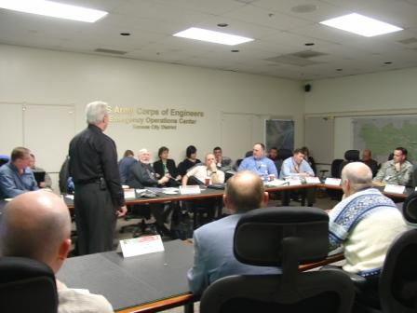
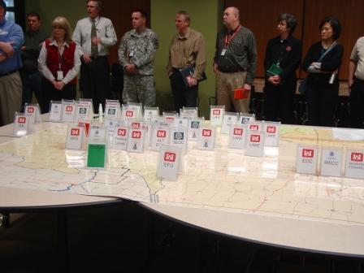
Emergency Response Exercises
3.
Simple
Complex
Tabletop Exercise
Notes:
My experience is: this type of exercise requires about three months of planning.

Slide 12
Emergency Response Exercises
Tabletop Exercise
3.
Simple
Complex
Describe simulated emergency.
Discussion of responses/actions.
Goal is to evaluate EAP, resolve responsibility, and coordination issues.
Build Relationships.
Preparation for Functional Exercise.
Notes:
My experience is: this type of exercise requires about three months of planning.

Slide 13
Scenario
Steady rain has been falling in the region for several weeks due to a moisture-laden low pressure system. Some roads had to be closed and a small number of residents had to be evacuated along overflowing streams downstream of the dam. The lake is at the top of the flood pool and still rising. All gates are closed to avoid imposing additional downstream flooding.
Sixteen hours have elapsed since the last round of rain began. Based on reports from designated citizens with rain gauges upstream and downstream of the dam, total rainfall across the jurisdiction ranges from 10 to 15 cm in the last 24 hours. The soil has reached the saturation point, causing extensive runoff. Designated river spotters, water level gauges, and/or electronic river rise warning devices indicate that the river downstream of the dam has risen to a dangerous level. Police report additional road closings due to high water, and a couple dozen more residents have been evacuated. Water levels are rising steadily, as a driving rain continues to fall.
The 24-hour forecast calls for continued rainfall. The lake level continues to rise and it will be necessary to open the spillway gates soon to avoid overtopping the dam. Power to the dam has been lost and the emergency generator will not start. It is now 3:00 pm.

Slide 14
Participants
Dam Owner
City Manager
Fire department and Police
Public works
Hospital
Airport
Schools
Communications
Volunteer organizations

Slide 15
Discussions
Who makes the decision to open the gates?
What is that decision based on?
How will you notify downstream community?
How much warning time will we have?
Where will people evacuate to?
Who manages evacuations?
Traffic control and public safety?
Power to operate gates?
What happens if dam overtops?

Slide 16
Emergency Response Exercises
Functional Exercise
4.
Simple
Complex
Highest level short of mobilizing staff and resources.
Similar to full scale exercise without moving equipment.
Stress-induced environment with time constraints.
Simulated events, ‘act-out’ responses, actual communication equipment.
Notes:
My experience is: This type exercise requires 6-9 months preparation.

Slide 17
Emergency Response Exercises
Functional Exercise
4.
Simple
Complex
Complex exercise with multiple locations.
Intended for policy, operations and coordination personnel as players.
Preceded by lower level exercises/drills.
$300K with months of preparation potential for >100 players.
Goal is to evaluate EAP, capability, coordination.
Notes:
My experience is: This type exercise requires 6-9 months preparation.

Slide 18
Emergency Response Exercises
Functional Exercise
4.
Simple
Complex
Observe use of physical facilities/EOC.
Test seldom used resources.
Evaluate inter-jurisdictional/inter-organizational communications and relationships.
Can have a mix of functional and full scale in one exercise.
Notes:
My experience is: This type exercise requires 6-9 months preparation.

Slide 19
Emergency Response Exercises
Full Scale Exercise
5.
Simple
Complex
Most complex, mobilize staff/resources and test equipment and warning system (push the button).
High stress environment, as realistic as possible.
Simulated events/victims, ‘play-out’ on-scene responses, demonstrate coordination and capability.
Goal: Evaluate all facets of emergency management system.
Notes:
My experience is: This exercise requires a full year of preparation, depending on the size of the exercise and the number of agencies participating.

Slide 20
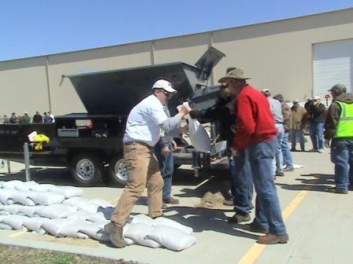
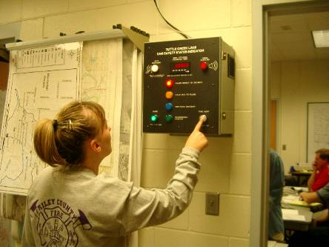
Emergency Response Exercises
Full Scale Exercise
5.
Simple
Complex
Most complex, mobilize staff/resources and test equipment and warning system (push the button).
One year planning and several hundred thousand dollars.
Notes:
My experience is: This exercise requires a full year of preparation, depending on the size of the exercise and the number of agencies participating.

Slide 21
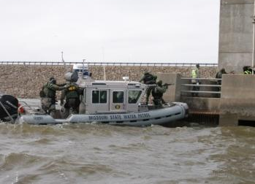
Emergency Response Exercises
Full Scale Exercise
5.
Simple
Complex
Simulated events, ‘play-out’ responses, demonstrate coordination and capability
Notes:
My experience is: This exercise requires a full year of preparation, depending on the size of the exercise and the number of agencies participating.

Slide 22
Functional Exercise
100+ People.
19 Agencies.
4 Locations.
4 Play Hours
Compressed Time
350 Messages

Slide 23
Agencies/Organizations
Fire department
Sheriff
Public works
Hospital
Airport
Schools
Communications
Volunteer organizations

Slide 24
Each Organization will Have Different Goals
May have exercise within an exercise.
May have their own
May do some limited full scale activities: mobilize people/equipment.

Slide 25
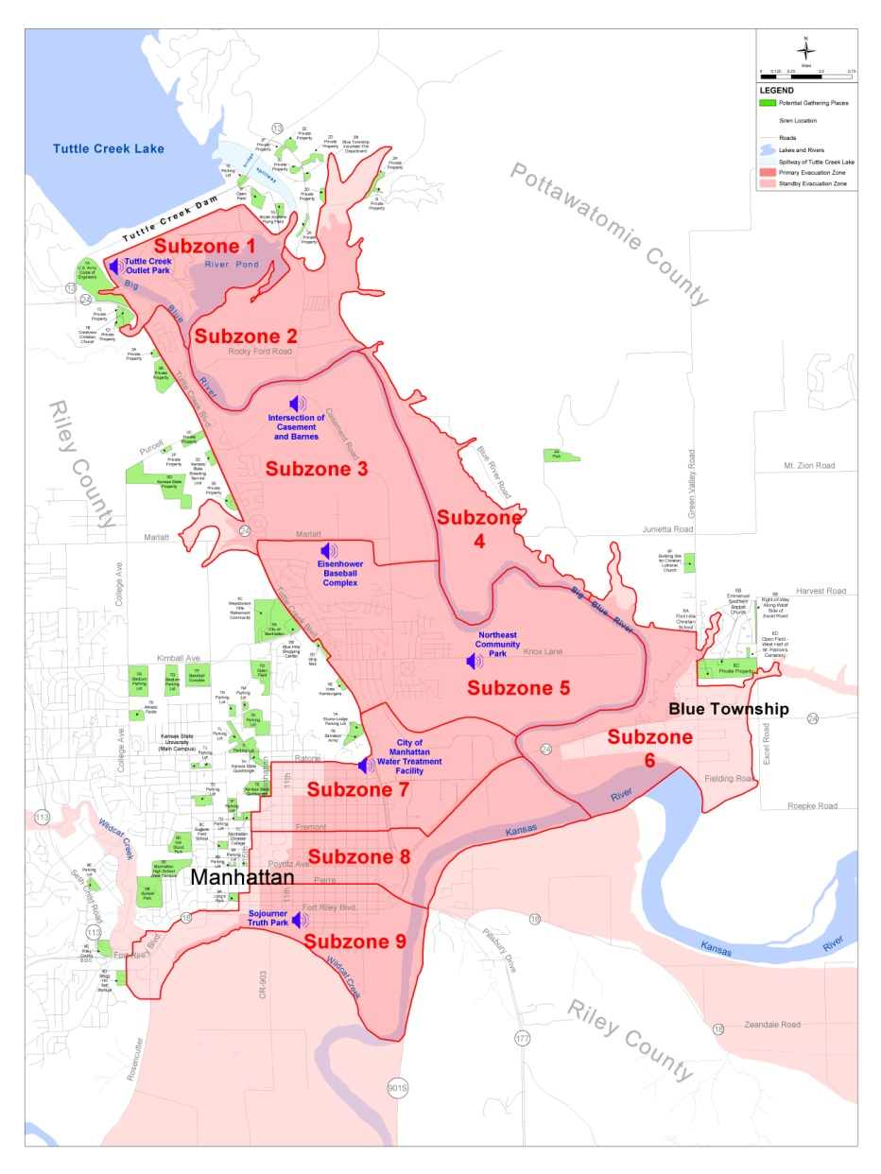
Exercise Multiple Locations
Project Critical
Systems Building
Fire Station
2 Rooms
Emergency
Operations Center

Slide 26
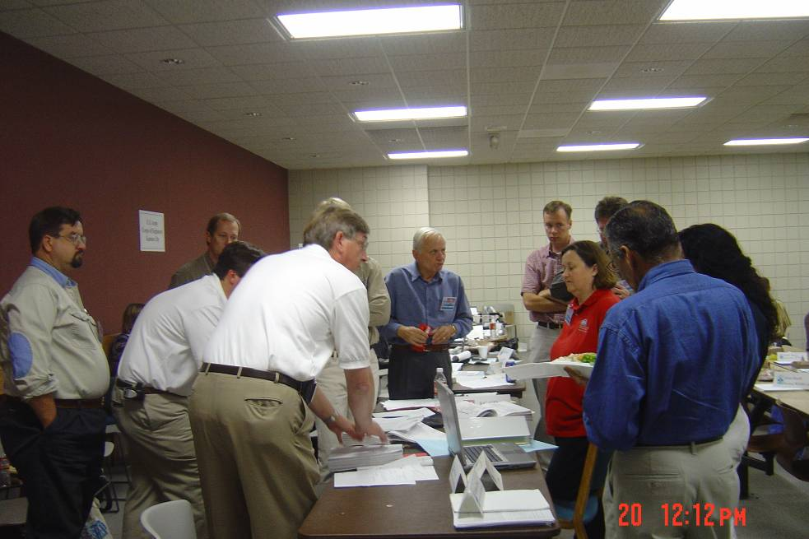
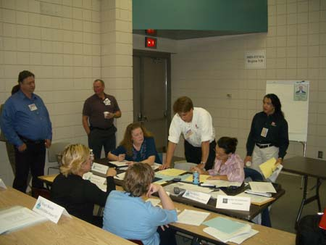
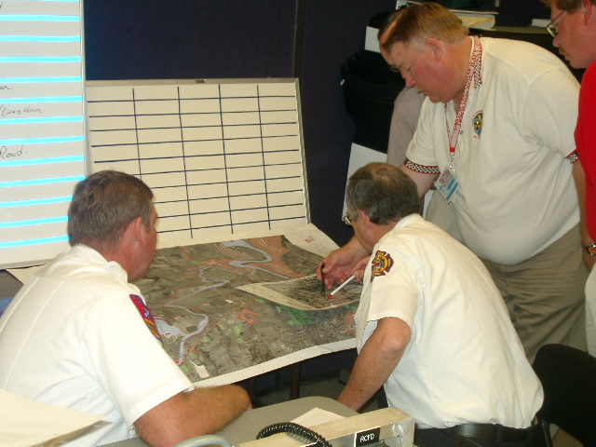
Physical Separation By Agency

Slide 27
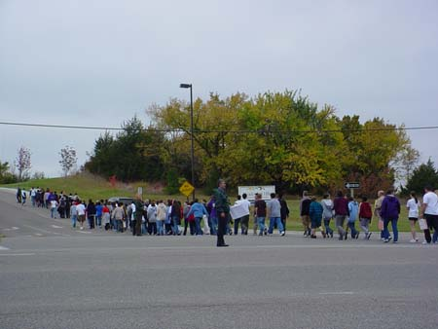
Evacuation Drills

Slide 28
Tests Evacuation Guidance & Maps

Slide 29
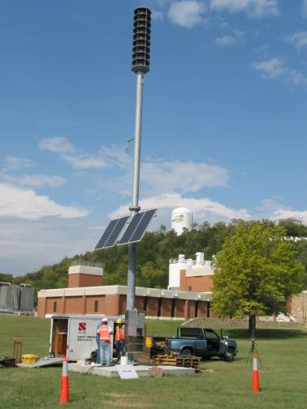
Exercise Warning System Activate Sirens Even if No one Wants to Push the Button

Slide 30
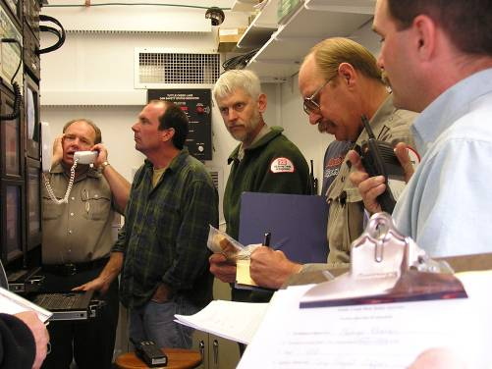
Functional Exercise for Local Responders and Project Office

Slide 31
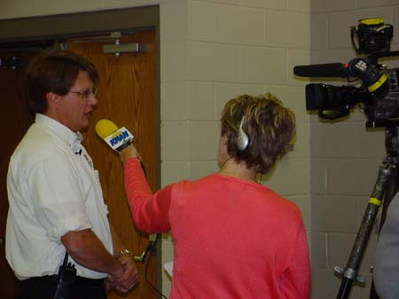
Involve the Media in the Exercise
Media Distracts from exercise and real response at multiple locations.
Set up Joint Information Center (JIC) for exercise.
Or Simulators.

Slide 32
THE EXERCISE PROCESS
1. Review Plan
2. Assess Needs
3. Define Scope and Objectives
Groundwork
Coordination
and
Logistical
Planning
4. Develop Objectives
5. Develop Narrative
6. Develop MSEL
7. Develop Messages
Develop
Scenario Package
Conduct
8. Conduct Exercise
9. Evaluate Exercise
10. Follow up on Recommendations
11. Revise Plan, if necessary
12. Repeat Steps 1-12
Follow-Up

Slide 33
Define Scope and Objectives
Why is the exercise being conducted.
What scenario is to be simulated.
What processes are to be tested.
What organizations are to be included.
What will not be tested or included.

Slide 34
Develop Background and Narrative
The conditions and events leading up to the current situation.
The general events that will occur during the exercise.
Used to define detailed messages to players and guide play.

Slide 35
Steady rain has been falling in the region due to a moisture-laden low pressure system. Early into the storm, a Flood Watch was issued by the National Weather Service (NWS). Within 10 hours after the rain began to fall, the NWS issued a Flood Warning for low-lying areas along small streams. Some roads had to be closed and a small number of residents had to be evacuated along overflowing streams located northwest of the city.
Sixteen hours have elapsed since the rain began. Based on reports from designated citizens with rain gauges, total rainfall across the jurisdiction ranges from 4.1 to 4.7 inches. The soil has reached the saturation point, causing extensive runoff. Designated river spotters, water level gauges, and/or electronic river rise warning devices indicate that the river has risen to a dangerous level.
The 24-hour forecast calls for continued rainfall, with a clearing trend possible. Based on this data, the NWS issues a Flood Warning for areas along the river basin. Police report additional road closings due to high water, and a couple dozen more residents have been evacuated. Water levels are rising steadily, as a driving rain continues to fall. It is now 3:00 p.m. The EOC has been opened and the staff has been assembled.

Slide 36
Set Ground Rules, Limitations and Assumptions
Time (compressed or actual)
Communication resources available.
Usually take a resource or two out of play.
Resources that are or are not available.
People that are or are not available.
Can take highly experienced out of play.
Phone numbers and other contact info.
Contained in a player handbook.

Slide 37
Write Messages with Expected Actions
Specific events for specific players.
Enough and at a frequency to keep everyone busy.
300 to 600 messages is not unusual.
Messages can be information, calls from public, calls from other agencies, requests, situations that require dispatching resources, information that needs to be shared, etc..

Slide 38
Write Messages with Expected Actions
Message #__1__ Time 4:15 pm
To: Dam Office
From: Public
There is a hole in the dam along the west end and there is water running out of the rock.
Anticipate: Send personnel to investigate.

Slide 39
Write Messages with Expected Actions
Message #__30__ Time 7:15 pm
To: Dam Manager
From: Maintenance Manager
Water running out of downstream face of dam is now very muddy and flow seems to be increasing. A large crowd is gathering below the dam
Anticipate: Equipment and materials deployed. Notifications made.

Slide 40
Write Messages with Expected Actions
Message #__35__ Time 7:30 pm
To: Police Department
From: Call from Public
Dam is failing and they need to evacuate people downstream.
Anticipate: Make contact with dam owner if not already in contact.

Slide 41
Write Messages with Expected Actions
Message #__50_ Time 9:15 pm
To: Dam Office
From: Call from boater on the lake.
There is a whirlpool in the lake by the dam and there is a family in a boat that couldn’t get their motor started that is being pulled toward the whirlpool.
Anticipate: Prioritize response. Confirm evacuation. Notify rescue personnel.

Slide 42
Write Messages with Expected Actions
Message #__120__ Time 12:10 am
To: All participants
From: Controllers
Cell phones have stopped working. The system must be overwhelmed.
Anticipate: Confirm available communication and divert to other communications.

Slide 43
Write Messages with Expected Actions
Message #__130__ Time 12:45 am
To: All participants
From: Controllers
Land line telephones are not working. The main phone line to the area comes in across the crest of the dam.
Anticipate: Confirm available communication and divert to other communications.

Slide 44
Write Messages with Expected Actions
Message #__145__ Time 1:20 am
To: Fire Department by radio
From: Engine 37 crew
Water continues to rise. River approaching flood stage. Debris is piling up at bridges. Many residents refuse to leave.
Anticipate: Adjust evacuation notification and reevaluate inundation mapping.

Slide 45
Notes on Messages
Always stress/eliminate communication paths.
No one ever has the whole story.
Same message can go to more than one player.
Can have very high rate of messages.
Can have false information/rumors.
Different pathways for incoming messages.

Slide 46
Exercise Team
CONTROLLER
SIMULATOR
SIMULATOR
CONDUCT
the
EXERCISE
PLAYERS
PLAYERS
EVALUATOR
EVALUATOR
OTHER OBSERVERS

Slide 47
Exercise Team
CONTROLLER
Must be a Chief Controller.
Control the exercise.
Plan and manage exercise play.
Can adjust or manage time or messages during play.
Minimum of one controller per location.

Slide 48
Exercise Team
CONTROLLER
SIMULATOR
SIMULATOR
Controller who role play during exercise.
Can show up as “media”.
Can make calls to players as public.
Can act as non-participating agency.

Slide 49
Exercise Team
PLAYERS
Active role responding to simulated emergency.
Serve in their normal role during exercise.
Log responses and actions
Respond and act as if event is real.

Slide 50
Exercise Team
EVALUATOR
OTHER OBSERVERS
Evaluators have standard form to record observations.
Should evaluate an area of expertise.
Minimum one per location.
Observers observe and do not interact.
Beware observers.

Slide 51
EVALUATE EXERCISE (not players):
After Action Review
The After Action Review IS the purpose of the exercise.
Learning during the exercise vs. learning during the emergency.
The lessons are the most important part of the entire event. The exercise is the way to get to them.

Slide 52
EVALUATE EXERCISE (not players):
After Action Review
To identify needed improvements in the EAP
To identify needed improvements in the emergency management system
To identify training needs
To identify staffing deficiencies
To determine whether objectives were achieved
To identify equipment needs
To identify any other needs

Slide 53
Communications is Always an Issue
Lack of technology.
Interoperability.
Interconnectivity.
Secondary channels
Information sharing.
Understanding.
Misinformation/Miscommunication/Rumors.

Slide 54
Exericise, Exercise, Exercise
All radio, telephone and email traffic should start and end with a clear indication that it is an exercise message.
Scanners and other electronics allow public to listen.
Frequent concern of a real emergency.

Slide 55
Other Common Lessons
No time to reference available info.
Physical space.
Roles and responsibilities.
Timely decisions; or lack thereof.
Levels of responsibility in crisis.

Slide 56
Address Issues Identified
Must adjust for lessons learned during exercise in a timely manner.

Slide 57
Real Emergencies During Exercises
Happens more than you might think.
Have predefined process for notification of end of exercise.

